Slide 1

Fact & Claim Verification System
By: TechCyber ➢Anirban Ray ➢Anusmita Ray Chaudhuri

Slide 2
Problem Statement
Problem Statement
In today’s digital world, ensuring the authenticity of information has become a major challenge:
➤ Rapid growth of AI-generated content leads to misinformation and hallucinations ➤ Users cannot easily verify the correctness of online text or news ➤ Manual fact-checking is time-consuming and not scalable ➤ Lack of reliable tools to validate real-time information
This creates a critical bottleneck where:
➤ False or misleading information spreads quickly ➤ Decision-making becomes unreliable and risky ➤ Trust in digital and AI-generated content decreases ➤ Organizations face challenges in maintaining data credibility

Slide 3
Objective
The goal of this project is to develop an intelligent system that ensures the reliability of digital content:
➤ Automatically extract verifiable claims from text or URLs ➤ Retrieve relevant, real-time evidence from trusted web sources ➤ Analyze and validate claims using AI-based verification techniques ➤ Classify claims as True, False, Partially True, or Unverifiable
The system aims to achieve the following outcomes:
➤ Generate a clear and detailed accuracy report with citations ➤ Provide confidence scores for each verified claim ➤ Reduce the spread of misinformation and AI hallucinations ➤ Build trust in AI-generated and online content

Slide 4
Target user
Target User:
Researchers, Journalists, Business Professionals, and General Users
➤ Need accurate and reliable information for decision-making ➤ Cannot manually verify large amounts of text or news ➤ Face difficulty identifying misinformation or fake content ➤ Require quick validation of AI-generated or online data
Pain Point:
Lack of instant and trustworthy fact-checking leads to misinformation and poor decisions
Goal:
Provide an automated, real-time fact verification system for accurate and trustworthy information

Slide 5
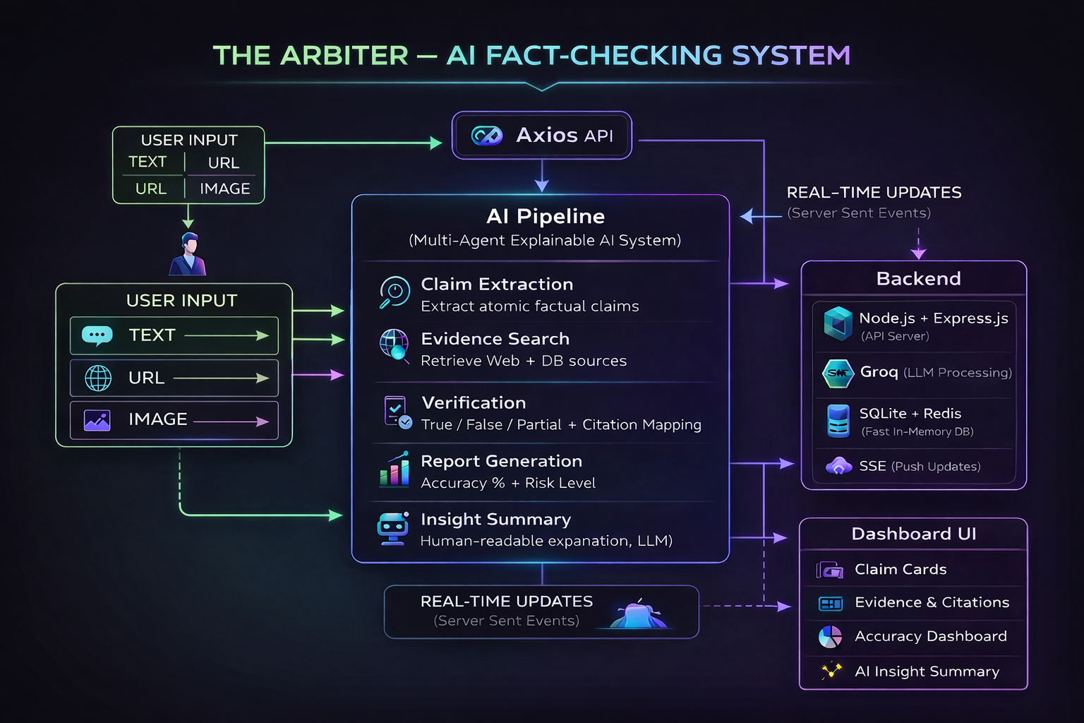
System Overview

Slide 6
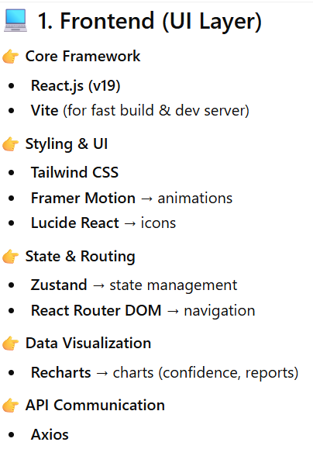
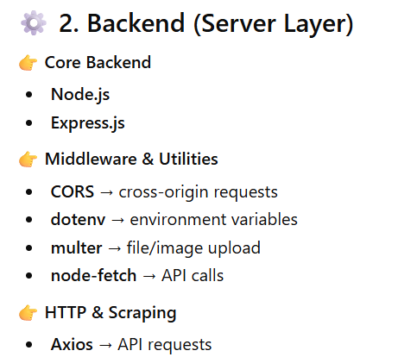


Tech Stack
Groq-sdk
tavily

Slide 7
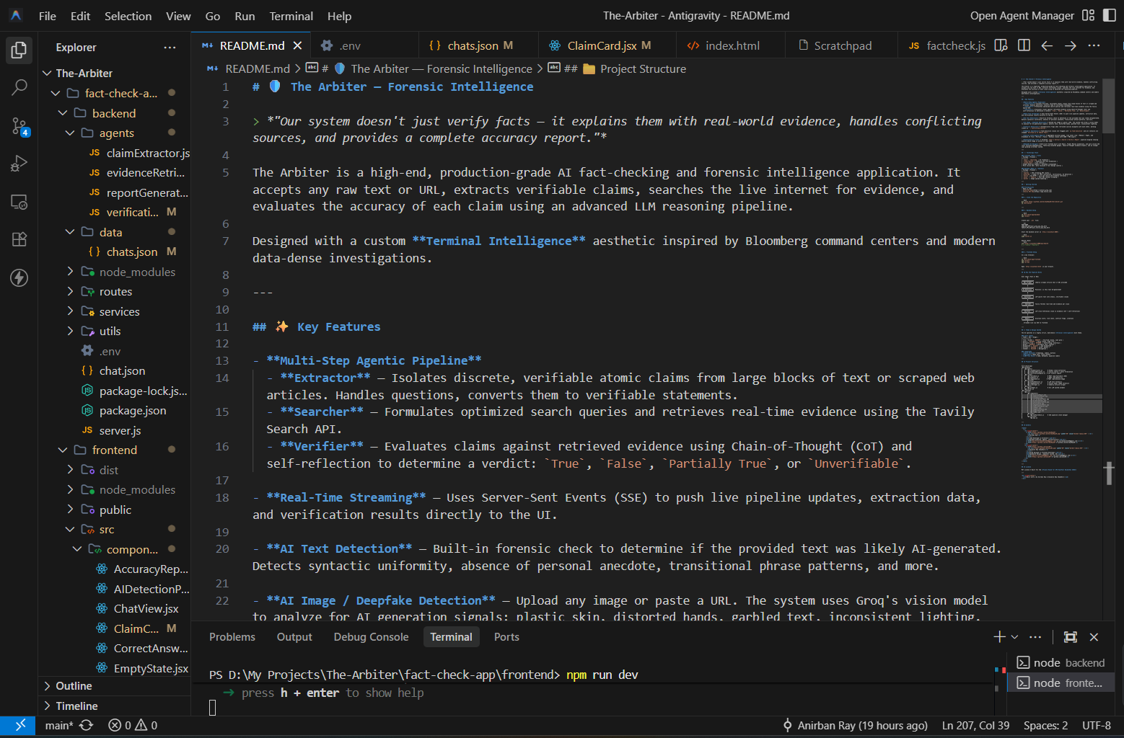
Architecture

Slide 8
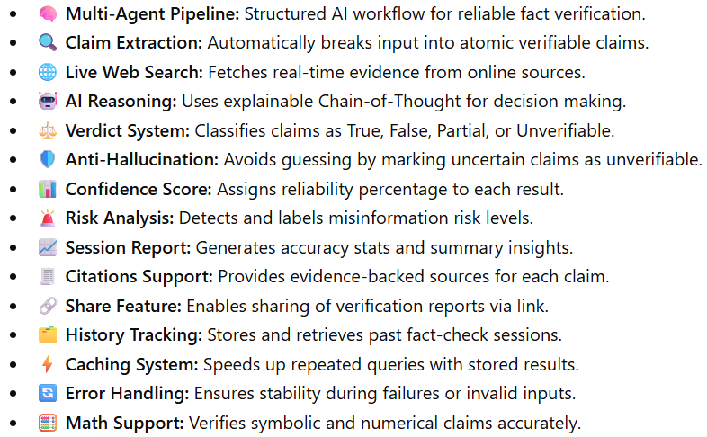

Key Features

Slide 9
Accuracy and Intelligence
➤ Claim-Aware AI Understanding ○ Extracts key factual claims from user input to avoid misinterpretation ○ Focuses only on verifiable statements for precise analysis
➤ Evidence-Based Verification Engine ○ Uses retrieved real-time evidence instead of relying only on AI knowledge ○ Ensures outputs are grounded in factual sources
➤ Intelligent Multi-Modal Analysis ○ Processes text, URLs, and images for comprehensive verification ○ Enhances system capability beyond traditional text-only models
➤ Robust Error Handling & Feedback ○ Detects unclear or invalid inputs and provides meaningful suggestions ○ Prevents system failure and improves user experience
Outcome: ○ Delivers accurate, explainable, and trustworthy fact-checking results with high reliability

Slide 10
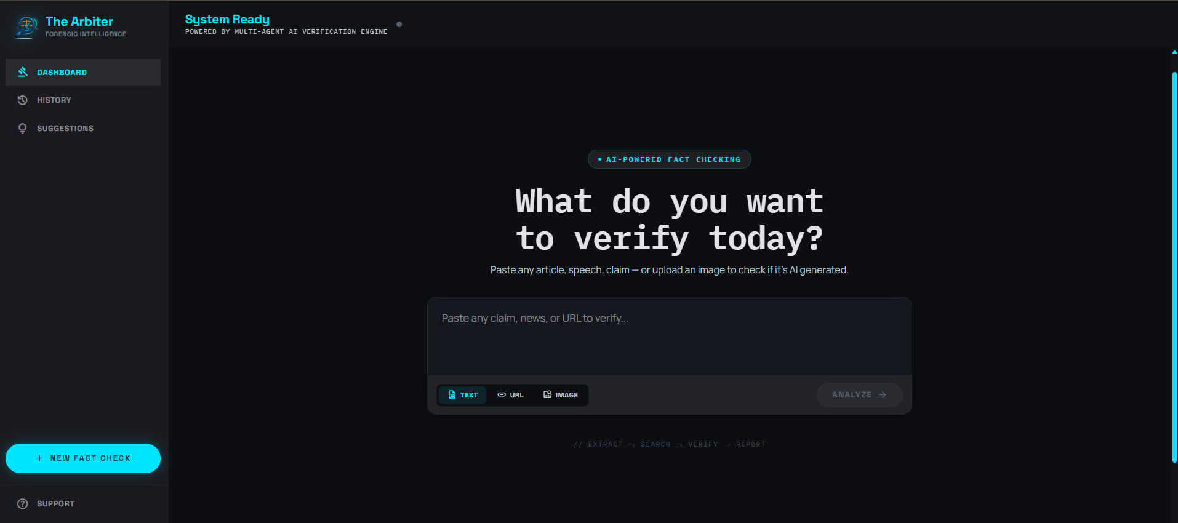
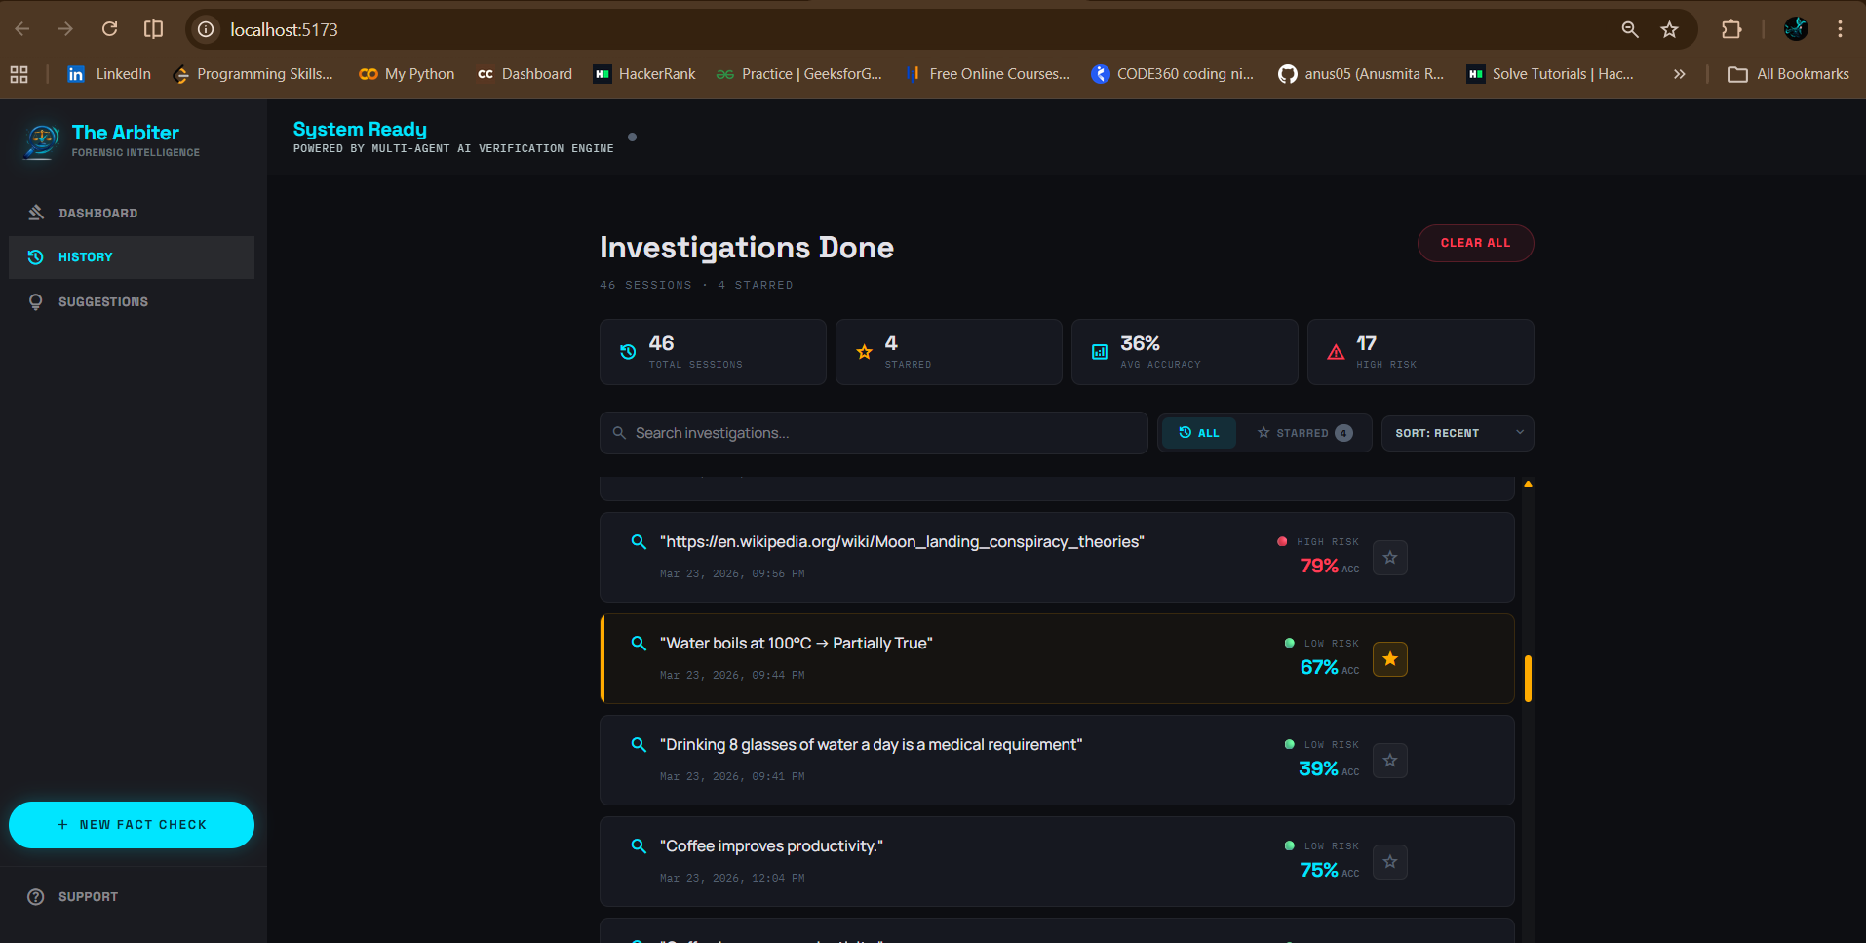
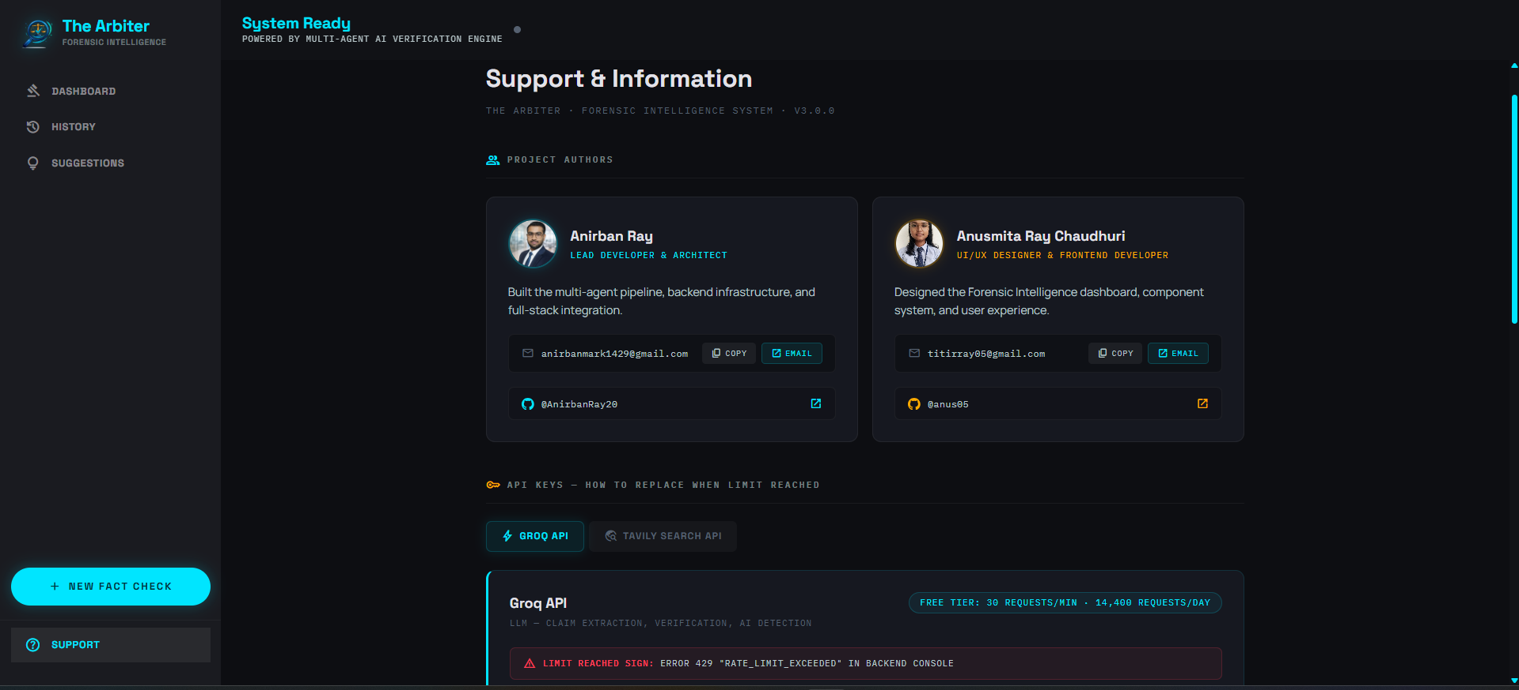
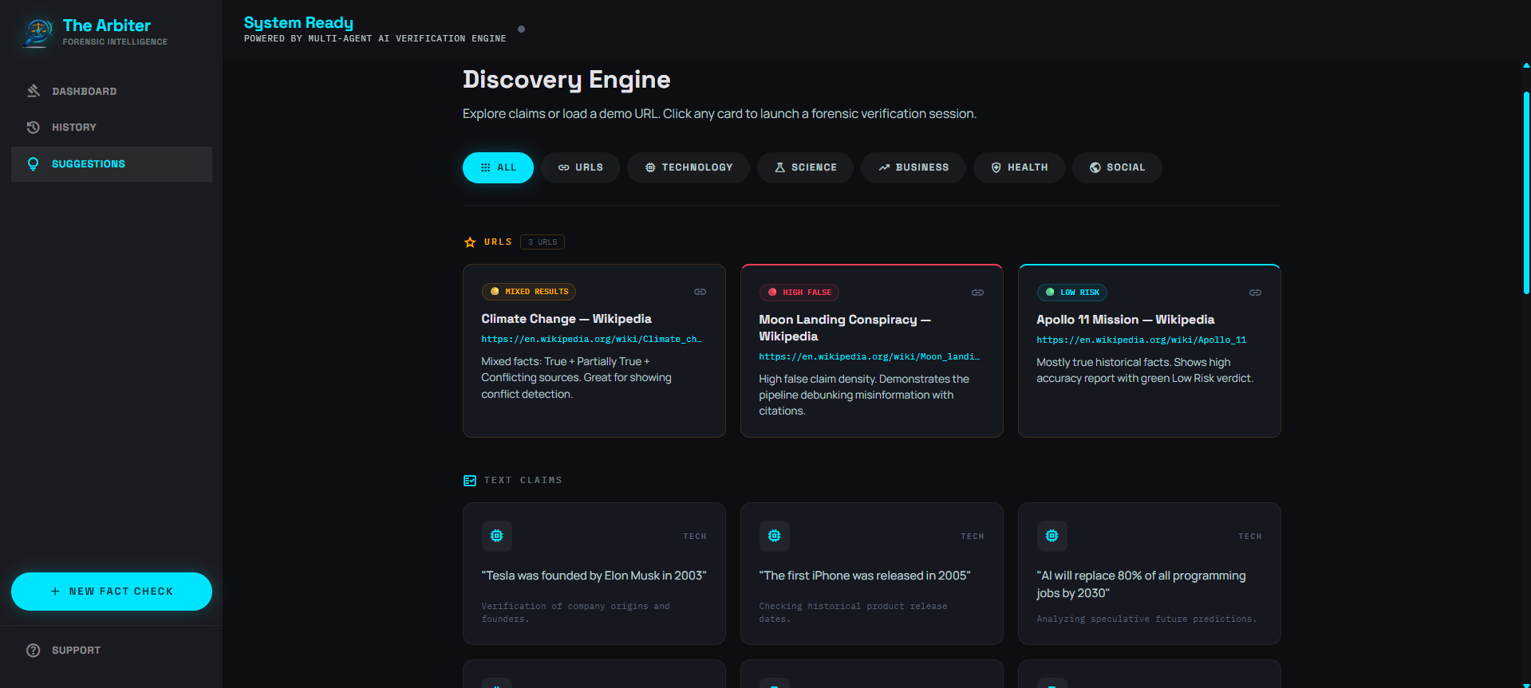
UI & UX

Slide 11
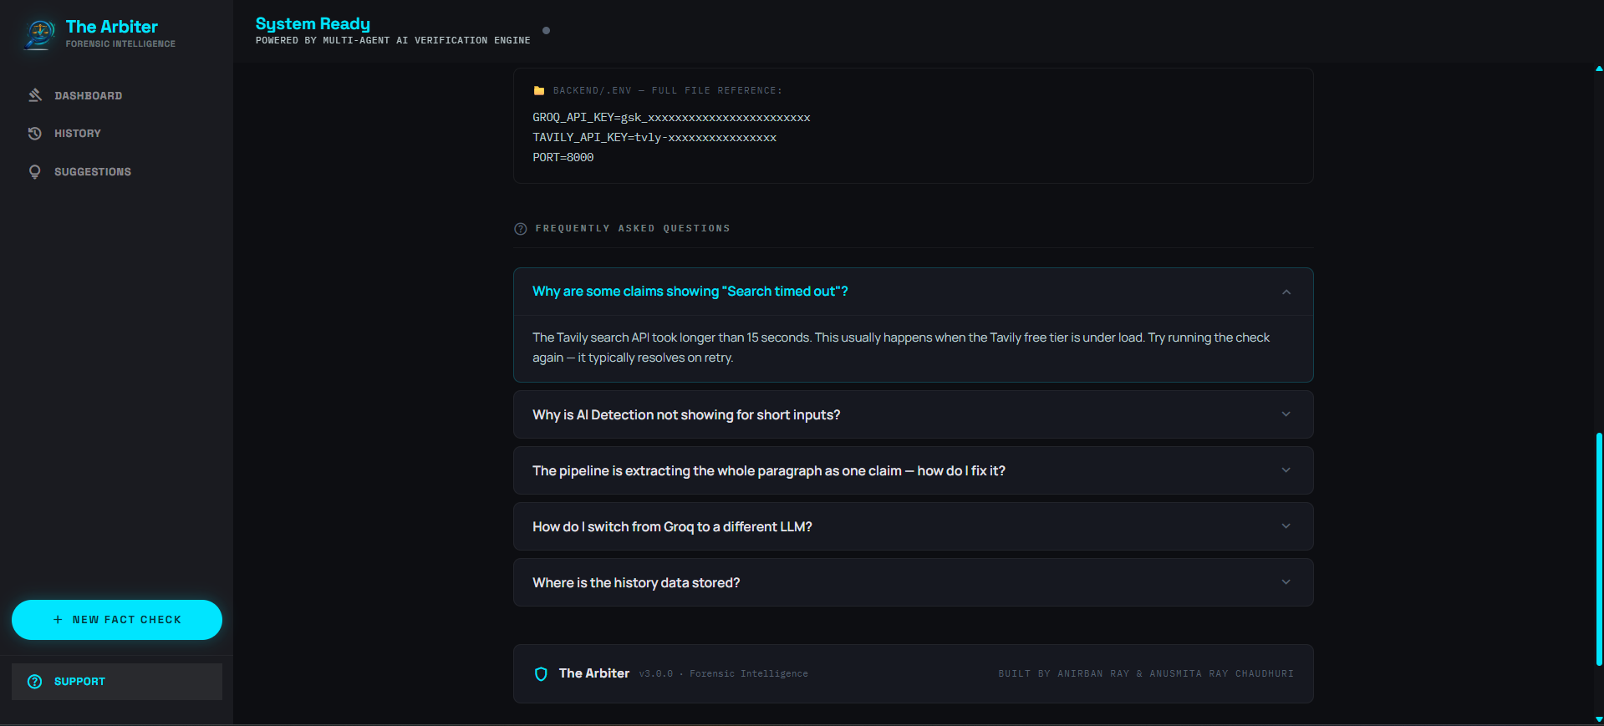
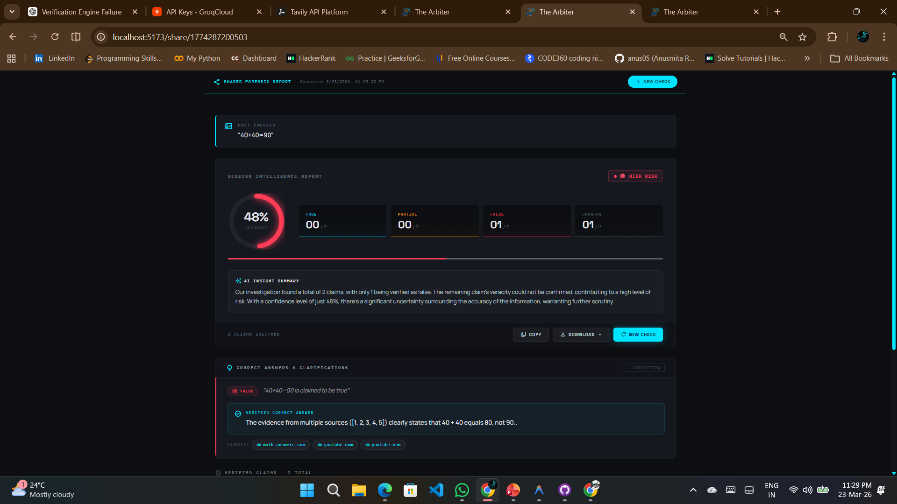
UI & UX

Slide 12
Innovation
Innovation
➤ Multi-Agent AI Architecture ○ Uses separate modules for claim extraction, evidence retrieval, verification, and report generation ○ Improves accuracy, scalability, and modular system design
➤ Real-Time Evidence Retrieval ○ Fetches live data from web sources using scraping techniques ○ Ensures up-to-date and reliable fact verification
➤ RAG-Based Verification System ○ Combines retrieved evidence with LLM reasoning ○ Reduces hallucinations and produces evidence-backed results
➤ Multi-Modal Input Support ○ Supports verification from text, URLs, and images ○ Makes the system practical for diverse real-world scenarios

Slide 13
Future Scope
Future Scope
➤ Advanced Conversational Fact-Checking ○ Enable interactive follow-up queries for deeper and more contextual verification ○ Allow users to refine results like a chatbot-based investigation system
➤ Integration with Trusted Knowledge Bases ○ Connect with verified sources like Wikipedia, news APIs, and fact-checking databases ○ Improve accuracy and credibility of verification results
➤ Real-Time Data & API Integration ○ Integrate live data sources and enterprise APIs for instant fact updates ○ Ensure continuously updated and dynamic verification

Slide 14
Conclusion
➤ Providing a Reliable AI-Based Fact Verification System ○ Ensures accurate and trustworthy information by combining AI with real-time evidence
➤ Reducing Misinformation and AI Hallucination ○ Uses evidence-backed verification (RAG) to minimize false or misleading outputs
➤ Supporting Multi-Modal and Real-Time Analysis ○ Enables verification of text, URLs, and images in a single unified platform

Slide 15
Thank You

